Slide 1
CHINESE REMAINDER THEOREM

Slide 2
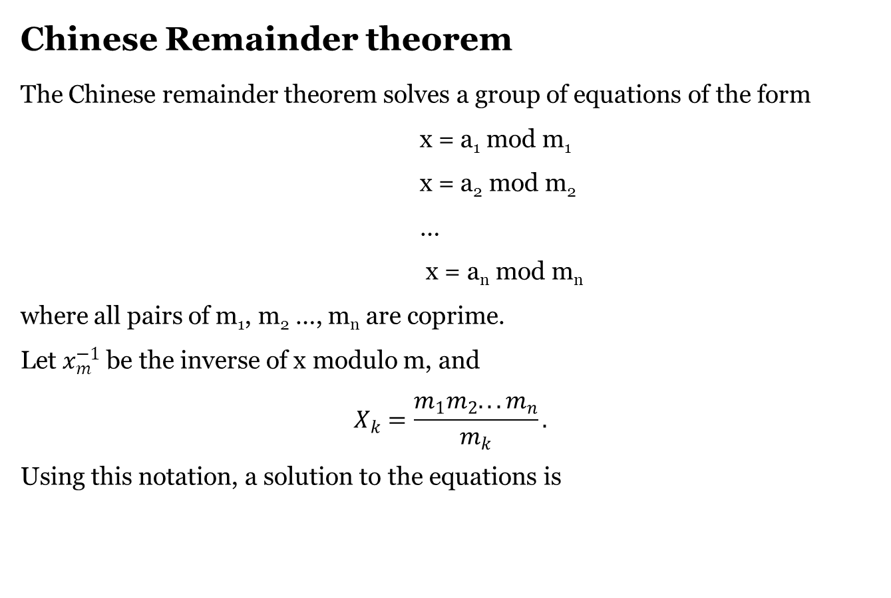
Chinese Remainder theorem
The Chinese remainder theorem solves a group of equations of the form
x = a₁ mod m₁
x = a₂ mod m₂
…
x = a_{n} mod m_{n}
where all pairs of m₁, m₂ …, m_{n} are coprime.
Let $x_{m}^{−1}$ be the inverse of x modulo m, and
$$X_{k}=\frac{m_{1}m_{2}...m_{n}}{m_{k}}.$$
Using this notation, a solution to the equations is

Slide 3
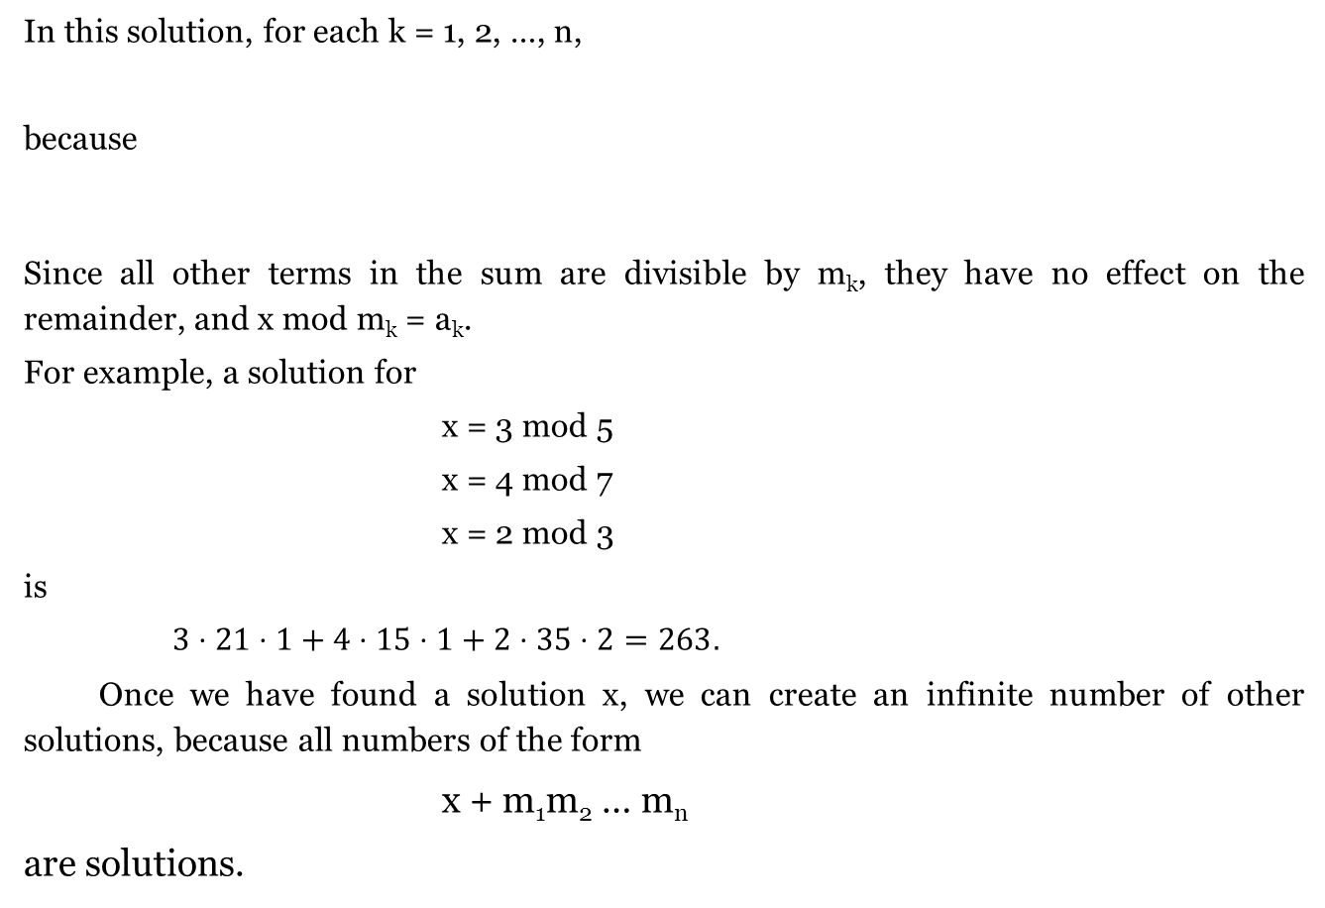
In this solution, for each k = 1, 2, …, n,
because
Since all other terms in the sum are divisible by m_{k}, they have no effect on the remainder, and x mod m_{k} = a_{k}.
For example, a solution for
x = 3 mod 5
x = 4 mod 7
x = 2 mod 3
is
$3⋅21⋅1+4⋅15⋅1+2⋅35⋅2=263.$
Once we have found a solution x, we can create an infinite number of other solutions, because all numbers of the form
x + m₁m₂ … m_{n}
are solutions.

Slide 4
Input: num[] = {5, 7}, rem[] = {1, 3}
Output: 31
Explanation:
31 is the smallest number such that:
(1) When we divide it by 5, we get remainder 1.
(2) When we divide it by 7, we get remainder 3.
Input: num[] = {3, 4, 5}, rem[] = {2, 3, 1}
Output: 11
Explanation:
11 is the smallest number such that:
(1) When we divide it by 3, we get remainder 2.
(2) When we divide it by 4, we get remainder 3.
(3) When we divide it by 5, we get remainder 1.

Slide 5
In a garden, there are several apple trees planted in a grid format. Each point (i, j) in the grid has | i | + | j | apples. Alice can buy a square plot centered at (0, 0). Find the minimum perimeter of the plot (1 unit having length = 1) such that she can collect at least X apples. All plants on the perimeter of the plot are also included.
Format:
Input:
X denotes the number of apples Alice has to collect.
Output:
Your function should return the minimum perimeter of the plot, which should be bought by Alice.

Slide 6
Example 1
Input:
1
Output:
8
Explanation:
Apples in each unit square will be | i | + | j | as a length of 1 unit will contain 0 apples (0,0). Hence, a plot of side length 2 will be taken keeping (0, 0) at the center.
Example 2
Input:
13
Output:
16

Slide 7
Thank You …

